Slide 1
Intention tremor | preliminary results
Julius Welzel
Kiel, 30. Oktober 2020

Slide 2
Block design
Training
Loud
Active
Loud
Active
Loud
Passive
Training
Fly
Active
Fly
Active
Fly
15 trials
5 vo
5 av
5 ao
39 trials
39 trials
39 trials replay block 1
10 trials
5 av
5 ao
39 trials
39 trials

Slide 3




Trial design
Max force (20, 25, 30%)
Scale (0.9-0.1)
+
Visual only
8 sec
1.0 – 1.5 sec
1.5 sec
1 sec

Slide 4

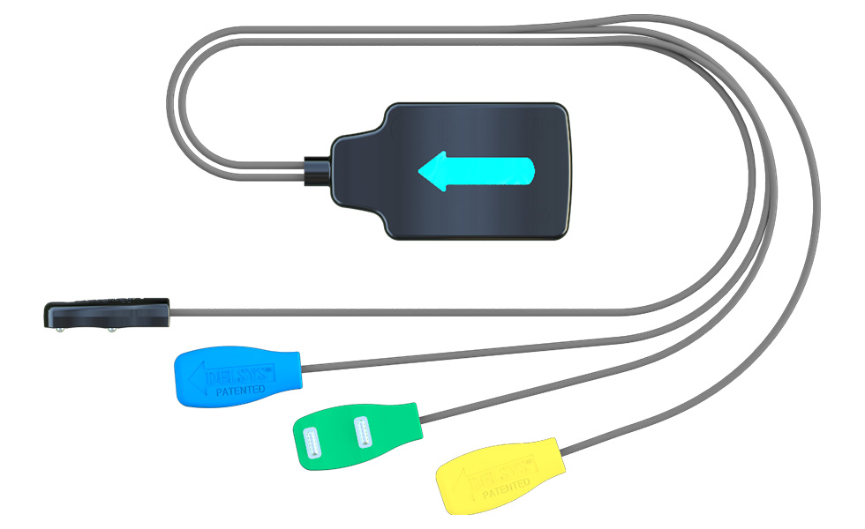

Experimental setup
actiChamp LSL
EEG
PupilCapture
PupilCapture LSL
PupilLabs
LabRecorder
PureData
PsychoPy
Python
EMG
(DelSys)
MatLab
Force Sensor (Arduino)

Slide 5
Scale vs power
Regression
Model |  |  | Sum of Squares |  | df |  | Mean Square |  | F |  | p
 | Regression |  | 3.700 |  | 4 |  | 0.925 |  | 2.090 |  | 0.080
 | Residual |  | 330.630 |  | 747 |  | 0.443
 | Total |  | 334.330 |  | 751
Coefficients
Model |  |  | Unstandardized |  | Standard Error |  | Standardized |  | t |  | p
 |  | Scaling | 0.236 |  | 0.107 |  | 0.080 |  | 2.206 |  | 0.028
 |  | RMSE | -0.004 |  | 0.003 |  | -0.049 |  | -1.337 |  | 0.182
 |  | Pupilsize left | 0.042 |  | 0.048 |  | 0.032 |  | 0.867 |  | 0.386
 |  | Pupilsize right | -0.038 |  | 0.039 |  | -0.036 |  | -0.975 |  | 0.330

Slide 6
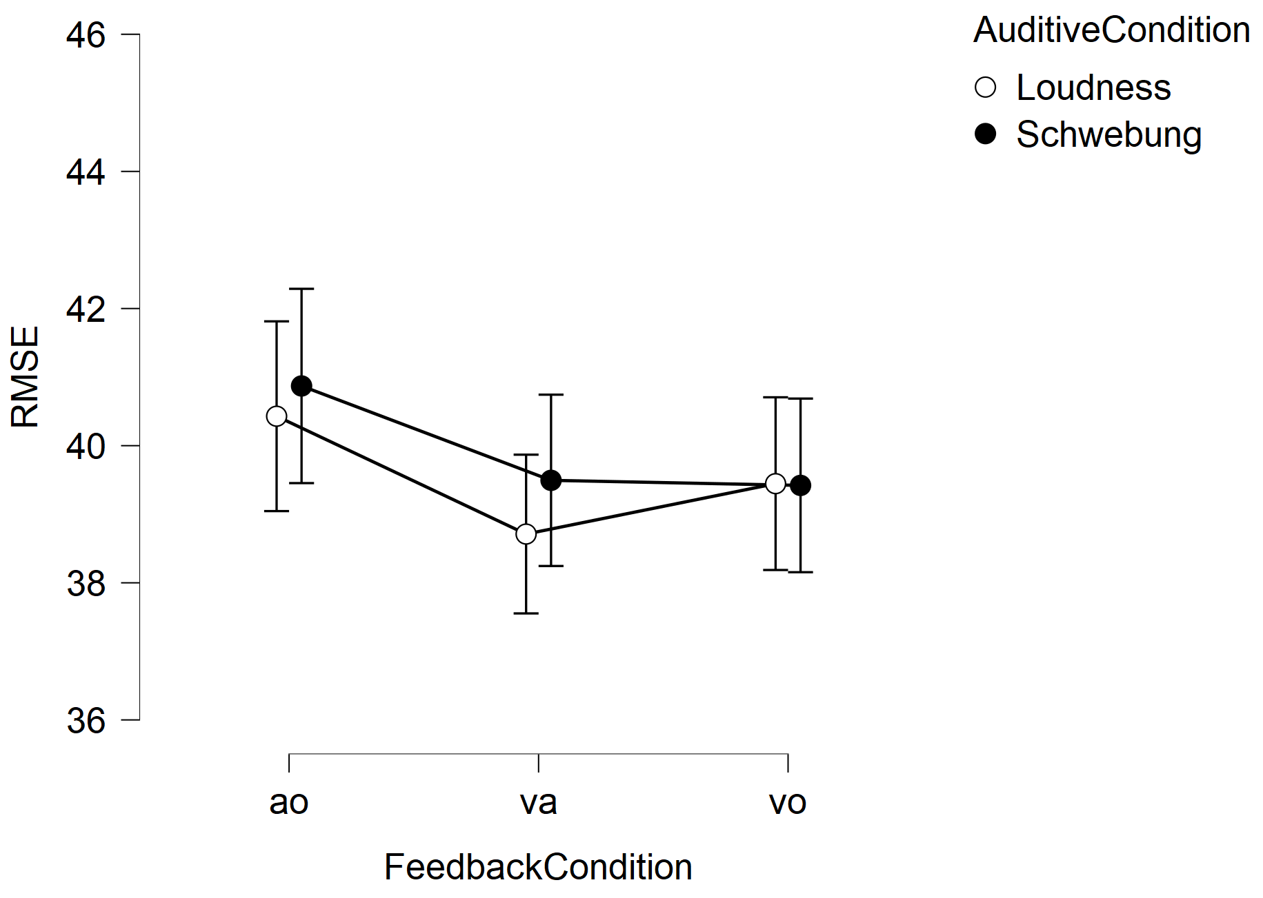
Pearson's Correlations
Variable |  | RMSE | Power [4-12 Hz] | n
1. RMSE | Pearson's r | —
 | p-value | —
2. Power [4-12 Hz] | Pearson's r | -0.045 | —
 | p-value | 0.197 | —
3. Trial n | Pearson's r | 0.016 | -0.074 | —
 | p-value | 0.645 | 0.033 | —

Slide 7
Pupil data
Model |  | Sum of Squares | df | Mean Square | F | p
 | Regression | 5.068 | 3 | 1.689 | 6.632 | < .001
 | Residual | 196.907 | 773 | 0.255
 | Total | 201.975 | 776
 | Unstandardized | Standard Error | Standardized | t | p
Scaling | 0.002 | 0.080 | 0.001 | 0.028 | 0.977
RMSE | 0.010 | 0.002 | 0.157 | 4.412 | < .001
Power [4-12 Hz] | 0.023 | 0.028 | 0.030 | 0.830 | 0.407

Slide 8

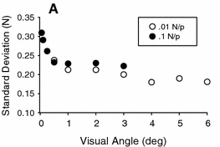

Viewing angle
(0.90 & 0.10) * ~24 cm
60 cm
110 cm
~12.9°
~1.3°
Vanillacourt ea., ExpBrainResearch, 2006

Slide 9
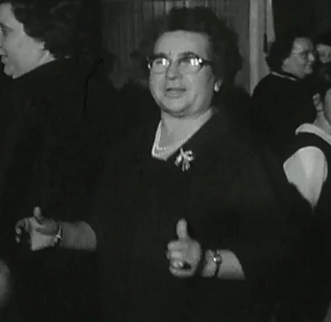
Vielen Dank für die Aufmerksamkeit

Slide 10
Intention tremor | preliminary results
Julius Welzel
Kiel, 14. May 2021

Slide 11
Block design
Training
Loud
Active
Loud
Active
Loud
Passive
Training
Fly
Active
Fly
Active
Fly
15 trials
5 vo
5 av
5 ao
39 trials
39 trials
39 trials replay block 1
10 trials
5 av
5 ao
39 trials
39 trials

Slide 12
Trial design
3 Factors:
Feedback (vo, av, ao)
Max force (15, 20, 25%)
Scale (0.9-0.1)
+
Visual only
6 sec
1.0 – 1.5 sec
1.5 sec
1 sec

Slide 13
Hypotheses

